Slide 1
Software Engineering
Topic 5: System Modelling and Design
Notes:
NCC Education - Title Master

Slide 2
The Unit Roadmap
Topic 1: Introduction
Topic 2: Introduction to Software Engineering Key Practices and Principles
Topic 3: Software Development Life Cycle Models
Topic 4: Requirement Engineering
Topic 5: System Modelling and Design
Topic 6: Software Implementation & Testing
Topic 7: System Dependency & Security
Topic 8: Project Management
Topic 9: Mini Project 1
Topic 10: Mini Project 2
Topic 11: Mini Project 3
Topic 12: Mini Project 4

Slide 3
Learning Outcomes
By the end of this topic students will be able to:
Explain software engineering design principles
Explain the purpose and range of modelling to produce quality software.
Create appropriate UML models for a well-defined scenario of limited scope.
Explain how the models embody the principles of good practice in software engineering

Slide 4
Scope and Coverage
This topic will cover:
Design principles:
Separation of concerns, Encapsulation and Abstraction, Loose Coupling and High Cohesion, Scalability and Performance, Resilience to Fault Tolerance, Security and Privacy.
Component based software engineering
UML modelling:
interaction, structural and behavioural models
Use Cases, Class diagrams, object diagrams, activity diagrams, sequence diagrams.
Patterns and architecture.
Notes:
NCC Education - Slide Master

Slide 5
System Modelling
The process of developing abstract models of system, with each model presenting a different view or perspective of the system:
External perspective
Interaction perspective
Structural perspective
Behavioural perspective
Unified Modelling Language (UML) is a widely used graphical notation for system modelling.
Models provide an abstract view of the system, helping to identify more detailed requirements, and capturing essential system features.
Models make system design and development easier as developers gain insights into the system’s behaviour, structure, and requirements.
Models guide implementation by providing a blueprint for development.

Slide 6
Build or Buy?
Commercial off- the-shelf systems (COTS) can be tailored to the users’ requirements in many domains:
E.g. if you want to implement a medical records system, you can buy a package that is already used in hospitals. It can be cheaper and faster to use this approach rather than developing a bespoke system.
The key issue is how well it meets your requirements:
The design process becomes concerned with how to use the configuration features of that system to deliver the system requirements.

Slide 7
System Design
Involves creating an architecture for different components, interfaces, and modules of a system, ensuring it meets end-user requirements.
Encompasses everything from hardware and software to data storage and communication.
Closely linked with implementation and requirements engineering.
UML can be used for big system and a piece of paper can be used for small and simple systems.

Slide 8
System Design Principles
Guide software development, ensuring robust, maintainable, and efficient software solutions:
Separation of Concerns:
Break the system into smaller, self-contained modules. Each module must have a clearly defined role, reducing reliance on other modules.
Encapsulation and Abstraction:
Minimise complexity and support information hiding by combining data and behaviour into a single object (encapsulation) and build simplified and logical representations of complex things (abstraction).
Loose Coupling and High Cohesion:
Low coupling describes modules that are independent (changes have limited impact on other modules).
High cohesion describes modules focused on a single goal.

Slide 9
System Design Principles
Scalability and Performance:
Design for scalability to handle growth and optimise performance by considering load balancing, caching, and database optimisation.
Resilience to Fault Tolerance:
Build systems that gracefully handle hardware, software, and network failures; implement redundancy, failover mechanisms, and error handling.
Security and Privacy:
Prioritise security, consider authentication, authorisation, encryption, and secure communication.

Slide 10

Unified Modelling Language (UML)
A general-purpose visual modelling language that provides a standard way to visualise the design of a system.
Developed at Rational Software in the mid-1990s and has its roots in various object-oriented modelling methods.

Slide 11
UML Notation (Diagrams)
Activity Diagram:
Shows the activities involved in a process (business process) and the flow between them.
Use case Diagram:
Illustrate interactions between actors (users or external systems) and the system.
Sequence Diagram:
Show interactions between objects over time.
Class Diagram:
Describe the structure of classes, their attributes, methods, and relationships.
State Diagram:
Shows how system reacts to internal and external events.

Slide 12
Object-Oriented Design
Object-Oriented Design (OOD) and Unified Modelling Language (UML) are closely related concepts in software engineering.
An object-oriented system is a software model that uses objects to represent different aspects of the application.
An object consists of data (attributes/ properties) and functions (methods)
A class is a template for a set of objects which defines their properties & methods
OOD includes design of object classes and their relationship.
OOD focuses on designing software using object-oriented principles, while UML provides a standardised way to visualise and communicate those designs.
Together, OOD and UML enhance software development and collaboration.

Slide 13
OOD Process
Object-oriented design process involves developing several different system models.
This requires a lot of effort for development and maintenance of these models.
For large systems developed by different groups, design models are an important communication mechanism.

Slide 14
OOD Process Stages
There are a variety of different object-oriented design processes that depend on the organisation using the process.
Common activities in these processes include:
Define the context and modes of use of the system;
Design the system architecture;
Identify the principal system objects;
Develop design models;
Specify object interfaces.
Process illustrated here using a design for a wilderness weather station.

Slide 15
System Context and Interactions
Understanding the relationships between the software that is being designed and its external environment is essential for deciding how to provide the required system functionality and how to structure the system to communicate with its environment.
Understanding of the context also lets you establish the boundaries of the system.
Setting the system boundaries helps you decide what features are implemented in the system being designed and what features are in other associated systems.

Slide 16
Context and Interaction Models
A system context model is a structural model that demonstrates the other systems in the environment of the system being developed.
An interaction model is a dynamic model that shows how the system interacts with its environment as it is used.

Slide 17
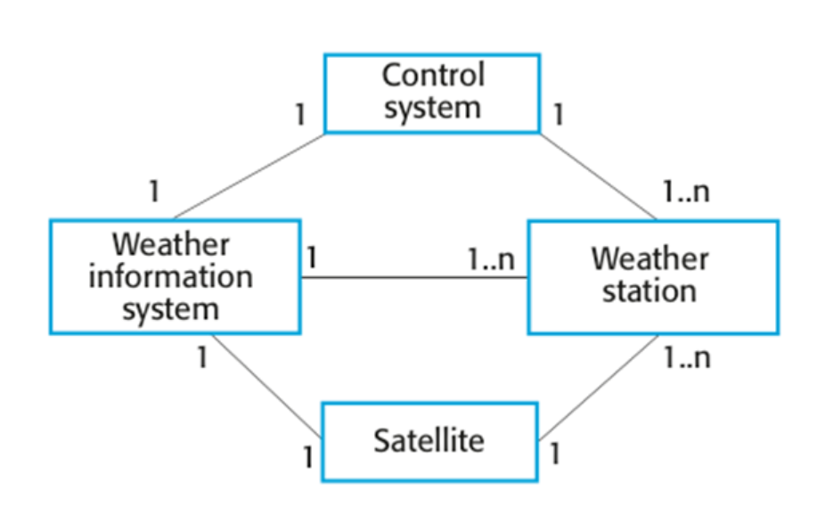
System Context For The Weather Station
Sommerville, I. (2016)

Slide 18
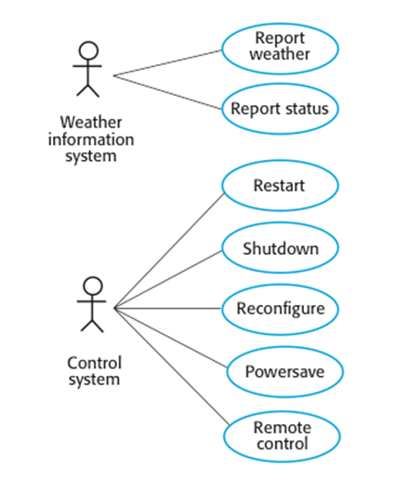
Weather Station Use Cases
Sommerville, I. (2016)

Slide 19
Use Case Description - Report Weather
System | Weather station
Use case | Report weather
Actors | Weather information system, Weather station
Description | Weather station sends summary of weather data collected from the instruments to the weather information system. The data sent are maximum, minimum, and average ground and air temperatures; the maximum, minimum, and average air pressures; the maximum, minimum, and average wind speeds; the total rainfall; and the wind direction as sampled at five-minute intervals.
Stimulus | Weather information system establishes a satellite communication link with the weather station and requests transmission of the data.
Response | The summarised data is sent to the weather information system.
Comments | Weather stations are usually asked to report once per hour, but frequency may differ between stations and may be modified in the future.

Slide 20
Architectural Design
Once interactions between the system and its environment have been understood, you use this information for designing the system architecture.
You identify the major components that make up the system and their interactions, and then may organise the components using an architectural pattern such as a layered or client-server model.
The weather station is composed of independent subsystems that communicate by broadcasting messages on a common infrastructure.

Slide 21
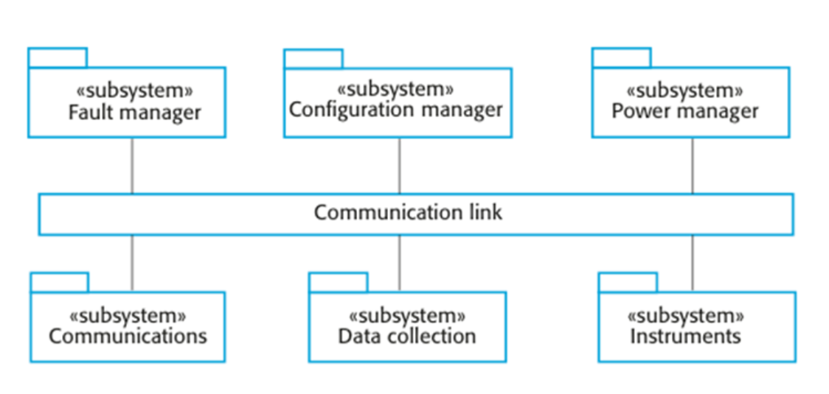
High-level Architecture Of The Weather Station
Sommerville, I. (2016)

Slide 22
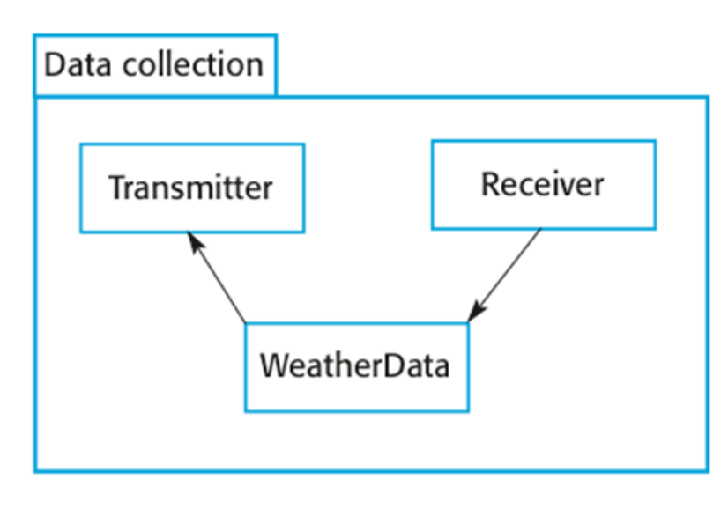
Architecture Of Data Collection System
Sommerville, I. (2016)

Slide 23
Object Class Identification
Identifying object classes is often a difficult part of object oriented design.
There is no 'magic formula' for object identification. It relies on the skill, experience and domain knowledge of system designers.
Object identification is an iterative process. You are unlikely to get it right first time.

Slide 24
Approaches to Identification
Use a grammatical approach based on a natural language description of the system.
Base the identification on tangible things in the application domain.
Use a behavioral approach and identify objects based on what participates in what behavior.
Use a scenario-based analysis. The objects, attributes and methods in each scenario are identified.

Slide 25
Weather Station Description
A weather station is a package of software controlled instruments which collects data, performs some data processing and transmits this data for further processing. The instruments include air and ground thermometers, an anemometer, a wind vane, a barometer and a rain gauge. Data is collected periodically.
When a command is issued to transmit the weather data, the weather station processes and summarises the collected data. The summarised data is transmitted to the mapping computer when a request is received.

Slide 26
Weather Station Object Classes
Object class identification in the weather station system may be based on the tangible hardware and data in the system:
Ground thermometer, Anemometer, Barometer
Application domain objects that are ‘hardware’ objects related to the instruments in the system.
Weather station
The basic interface of the weather station to its environment. It therefore reflects the interactions identified in the use-case model.
Weather data
Encapsulates the summarised data from the instruments.

Slide 27
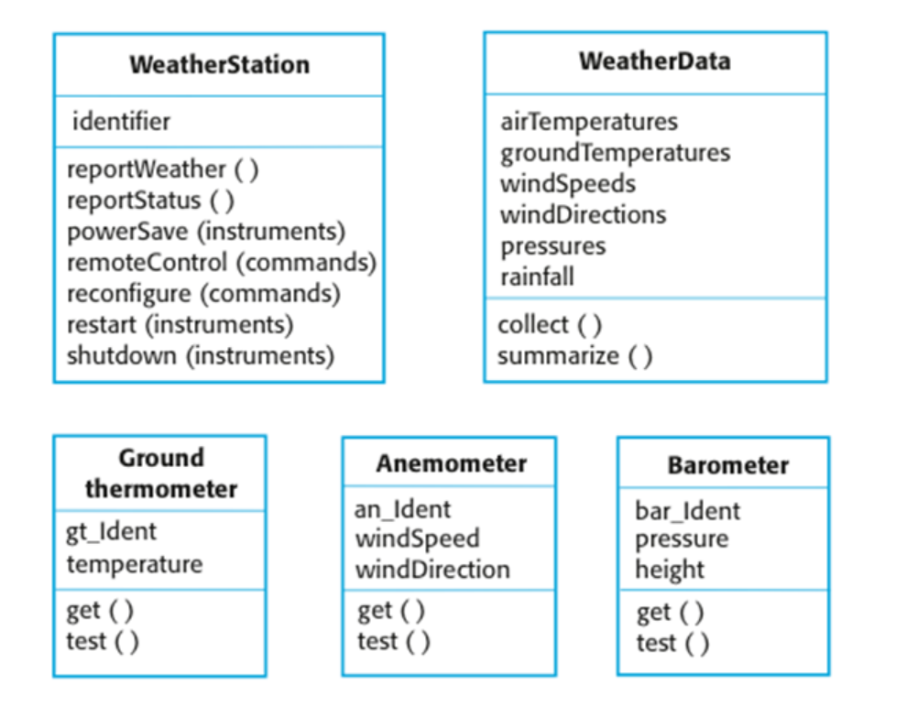
Weather Station Object Classes
Attributes
Methods
Sommerville, I. (2016)

Slide 28
Design Models
Design models show the objects and object classes and relationships between these entities.
Static models describe the static structure of the system terms of object classes and relationships.
Dynamic models describe the dynamic interactions between objects (behaviour over time).

Slide 29
Examples Of Design Models
Subsystem models that show logical groupings of objects into coherent subsystems.
Sequence models that show the sequence of object interactions.
State machine models that show how individual object change their state in response to events.
Other models include use-case models, aggregation models, generalisation models, etc.

Slide 30
Subsystem Models
Shows how the design is organised into logically related groups of objects.
In the UML, these are shown using packages - an encapsulation construct. This is a logical model. The actual organisation of objects in the system may be different.

Slide 31
Sequence Models
Sequence models show the sequence of object interactions that take place.
Objects are arranged horizontally across the top;
Time is represented vertically so models are read top to bottom;
Interactions are represented by labelled arrows;
Different styles of arrow represent different types of interaction;
A thin rectangle in an object lifeline represents the time when the object is the controlling object in the system.

Slide 32
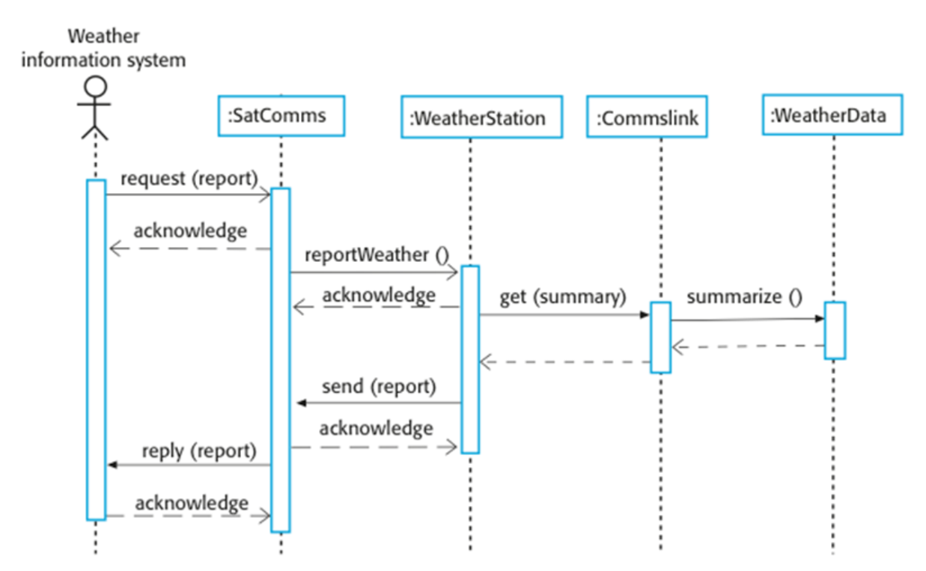
Sequence Diagram Describing Data Collection
Sommerville, I. (2016)

Slide 33
State Diagram
Used to show how objects respond to different service requests and the state transitions triggered by these requests.
Useful high-level models of a system or an object’s run-time behavior.
You don’t usually need a state diagram for all of the objects in the system. Many of the objects in a system are relatively simple and a state model adds unnecessary detail to the design.

Slide 34
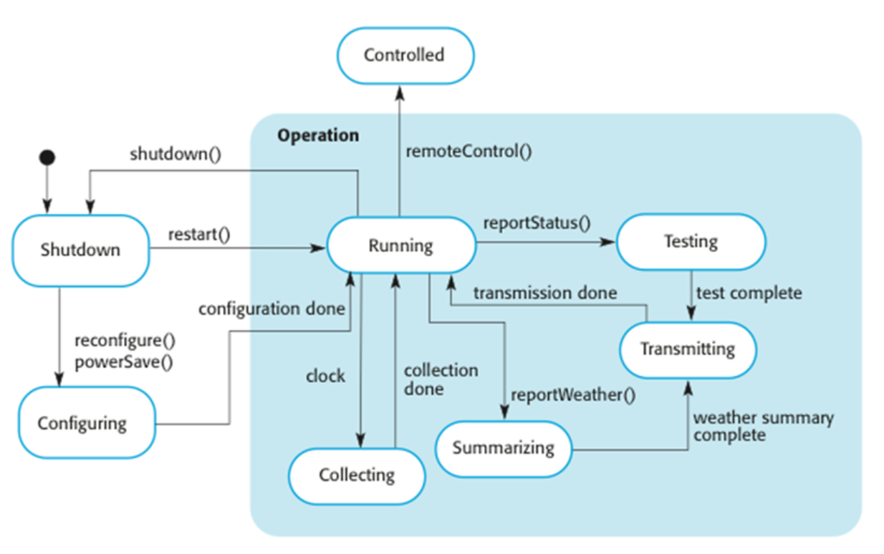
Weather Station State Diagram
Sommerville, I. (2016)

Slide 35
Interface Specification
Object interfaces must be specified so that the objects and other components can be designed in parallel.
Designers should avoid designing the interface representation but should hide this in the object itself.
Objects may have several interfaces which are viewpoints on the methods provided.
The UML uses class diagrams for interface specification but Java may also be used.

Slide 36
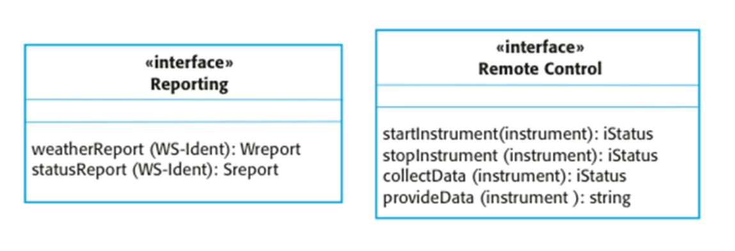
Weather Station interfaces
Sommerville, I. (2016)

Slide 37
Design Patterns
A way of reusing abstract knowledge about a problem and its solution.
A pattern is a description of the problem and the essence of its solution.
It should be sufficiently abstract to be reused in different settings.
Pattern descriptions usually make use of object-oriented characteristics such as inheritance and polymorphism.

Slide 38
Pattern Elements
Name
A meaningful pattern identifier.
Problem description
Solution description
Not a concrete design but a template for a design solution that can be instantiated in different ways.
Consequences
The results and trade-offs of applying the pattern.

Slide 39
The Observer Pattern (1)
Pattern name | Observer
Description | Separates the display of the state of an object from the object itself and allows alternative displays to be provided. When the object state changes, all displays are automatically notified and updated to reflect the change.
Problem description | In many situations, you have to provide multiple displays of state information, such as a graphical display and a tabular display. Not all of these may be known when the information is specified. All alternative presentations should support interaction and, when the state is changed, all displays must be updated. This pattern may be used in all situations where more than one display format for state information is required and where it is not necessary for the object that maintains the state information to know about the specific display formats used.

Slide 40
The Observer pattern (2)
Pattern name | Observer
Solution description | Involves two abstract objects, Subject and Observer, and two concrete objects, ConcreteSubject and ConcreteObject, which inherit the attributes of the related abstract objects. The abstract objects include general operations that are applicable in all situations. The state to be displayed is maintained in ConcreteSubject, which inherits operations from Subject allowing it to add and remove Observers (each observer corresponds to a display) and to issue a notification when the state has changed. The ConcreteObserver maintains a copy of the state of ConcreteSubject and implements the Update() interface of Observer that allows these copies to be kept in step. The ConcreteObserver automatically displays the state and reflects changes whenever the state is updated.
Consequences | The subject only knows the abstract Observer and does not know details of the concrete class. Therefore there is minimal coupling between these objects. Because of this lack of knowledge, optimisations that enhance display performance are impractical. Changes to the subject may cause a set of linked updates to observers to be generated, some of which may not be necessary.

Slide 41
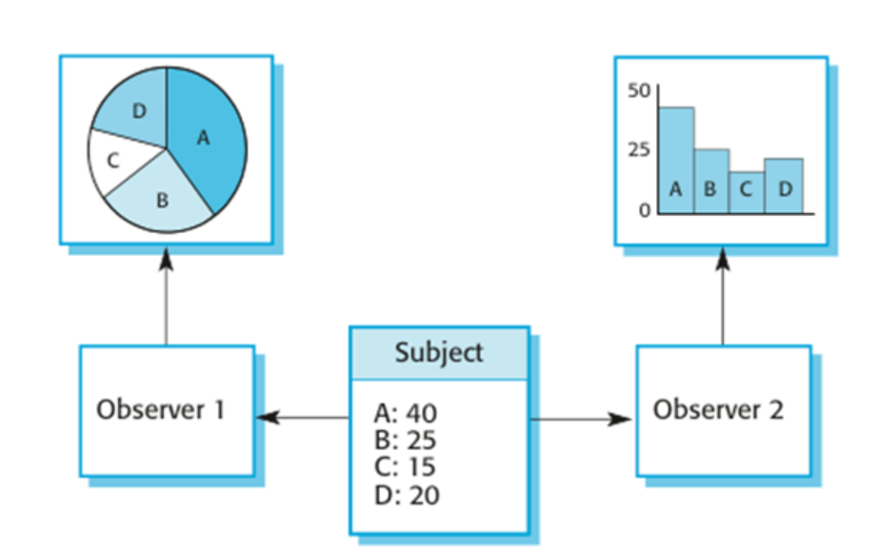
Multiple Displays Using The Observer Pattern
Sommerville, I. (2016)

Slide 42
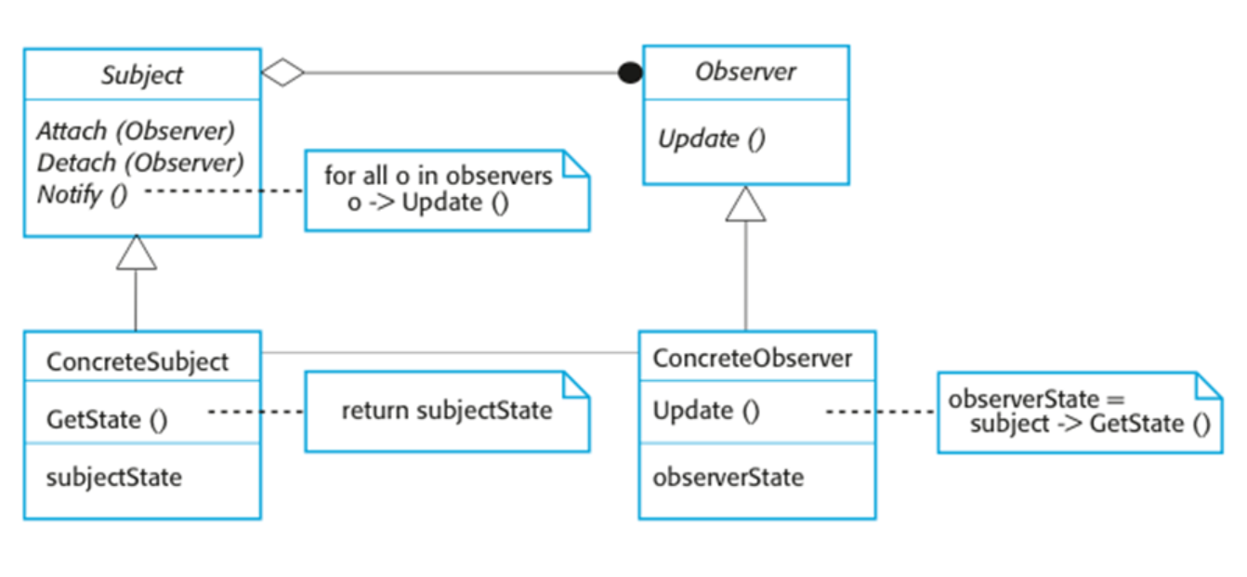
A UML Model Of The Observer Pattern
Sommerville, I. (2016)

Slide 43
Design Problems
To use patterns in your design, you need to recognise that any design problem you are facing may have an associated pattern that can be applied.
Tell several objects that the state of some other object has changed (Observer pattern).
Tidy up the interfaces to a number of related objects that have often been developed incrementally (Façade pattern).
Provide a standard way of accessing the elements in a collection, irrespective of how that collection is implemented (Iterator pattern).
Allow for the possibility of extending the functionality of an existing class at run-time (Decorator pattern).

Slide 44
Checkpoint Summary
System modelling is the process of developing abstract models of system, with each model presenting a different view or perspective of the system
UML Diagrams include use case, activity, state, sequential, class diagrams and are useful tools for system modelling.
Design is the stage of SE in which software components and their relations are identified
Object-oriented design includes design of object classes and their relationship
Design patterns are reusable solutions for common problems in software development

Slide 45
Quiz
False or True:
System modeling is about looking at the system from different perspectives
In activity diagram we model the interaction of system users and system components
We use system modeling for requirement engineering
Fill the gaps:
In ------------ diagram, we model the business process of a system
Design patterns include description of a common -------- and its ----
In object-oriented programming, everything is considered an object including -------------, ------------ and ------------.
The process to identify the major components that make up the system and their interactions, and then to organise the components using is ----------------------------------.

Slide 46
Private Study: Laboratory Lab
Download UML software: https://www.umldesigner.org/download/
Find the main elements of below diagram:
use case diagram
activity diagram
class diagram
Draw above diagram for a “online food delivery” software system.

Slide 47
The Unit Roadmap
Topic 1: Introduction
Topic 2: Introduction to Software Engineering Key Practices and Principles
Topic 3: Software Development Life Cycle Models
Topic 4: Requirement Engineering
Topic 5: System Modelling & Design
Topic 6: Software Implementation & Testing
Topic 7: System Dependency & Security
Topic 8: Project Management
Topic 9: Mini Project 1
Topic 10: Mini Project 2
Topic 11: Mini Project 3
Topic 12: Mini Project 4

Slide 48
Next Session – Topic 6
At the end of this session, you should be able to:
Discuss the role of system implementation , testing and maintenance in software engineering.
Explain methods and techniques for software testing and change management

Slide 49
References
Sommerville, I. (2016), Software Engineering, 10th edition, London: Pearson.

Slide 50
Topic 5 – System Modelling and Design
Any Questions?
Notes:
NCC Education - End Slide Master

